Slide 1
Power Performance and Security Levels in Computing Devices
CSE 561
Freddy Chiu
Michael Manzano

Slide 2

Goal
Model critical components in the authentication flow to understand power performance based on different security levels from a device’s perspective.

Slide 3
Security Levels
Level 1:
Encryption required
No identify proofing
Level 2:
Single factor authentication (one time password, pin, security question, fingerprint, etc)
Level 3:
Repudiation
Levels 1 and 2: Kerberos (KDC)
Level 3: Public Key Infrastructure (PKI)

Slide 4
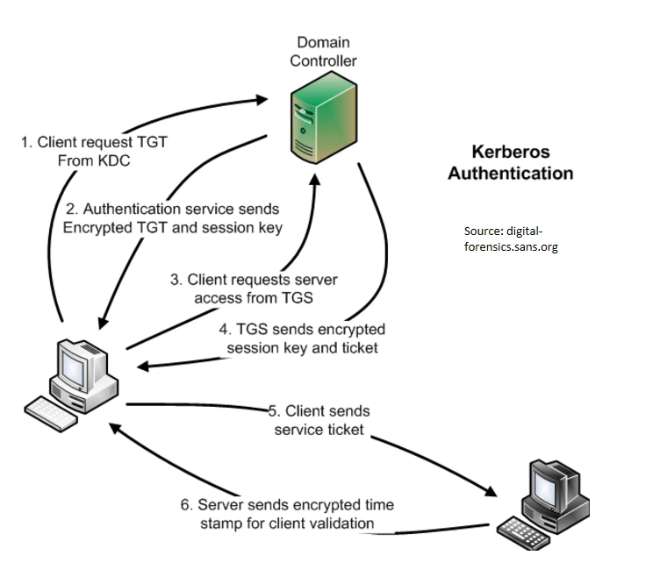
Kerberos (KDC) and Public Key Infrastructure (PKI)

Slide 5
Simplified Interactions
1
Device
Authentication Server
2
3
Receiver

Slide 6
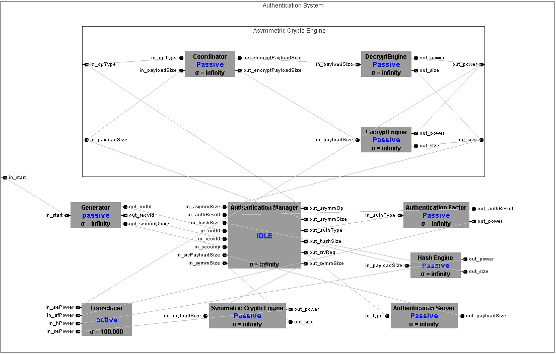

Slide 7
Experiment Setup
All experiments done across 3 levels of security
Record power consumption on payload sizes of:
0B, 1024B, 2048B, 3072B, 4096B
Power consumption of different specifications
AES128: 1.62 mjPerByte (Symmetric encryption)
RSA1024 Encrypt: 15.2 mjPerByte (Asymmetric encryption)
ECDSA160: 2.2545 mjPerByte (Asymmetric decryption)
SHA1: 5.9 mjPerByte (Hash)

Slide 8
Total Power

Slide 9
Symmetric Encryption Usage

Slide 10
Level 3 – Hash engine power consumption (mJ)

Slide 11
Level 3 - Asymmetric power consumption (mJ)

